Slide 1
NLP System for Creating Relevant Question and Answer based on Job role
Group 32

Slide 2
Team
Team Lead: Prof. Sudarshan Deshmukh
Mentor: Shubhendu Jain
Group 32:
Dheeraj TV (2019AIML623)
Kayamkhani Taher Abbasbhai (2019AIML599)
Komal Batra (2019AIML649)
Pavan IV (2019AIML626)

Slide 3
Agenda
Problem Statement
Objective
Business Understanding
Approach
Architecture
Dataset
Text Parsing and Exploratory Data Analysis (EDA)
Comparative Study
Model Performance
Deployment
Highlights of the solution
Demo
Future scope of work

Slide 4
Problem Statement
Due to different reasons like lack of domain knowledge, experience, preparation time etc., many a times the questions asked to evaluate the candidate are not useful to understand his/her capabilities.
An AI based approach will provide level wise list of question and answers which will help the interviewer to assess the applicant better than traditional approach.

Slide 5
Objective
Build an NLP based system to recommend the relevant questions and their standard answers based on role and experience, which will help the interviewer to assess the applicant better than traditional approach.

Slide 6
Business Understanding
Implement an NLP system to recommend the relevant questions and their standard answers based on role and experience.
Data set should be created for various job descriptions from various domains like Cloud, Data Science Engineer, Manufacturing, Product Manager, Business Analyst and AI etc., and creates Tags such as Skills, responsibility and department using Name Entity Recognition model and manually filter the required tags.
Once this dataset is ready, Model will be trained to identify the Entities.
Once this training is completed, after that if we test the model with some new JD, then it will identify responsibility and role from that JD based on context also, and then it will find similarity of that responsibility with the one available in metadata then accordingly.
Model will be trained on question and answers from various tags like Skills, responsibility and department from various domains like Cloud Architect, Data Science Engineer, Data Architect, Product Manager, Business Analyst and AI etc.,
Model will respond back with the relevant Question and Answers based on the given Tag(s), which will help the interviewer to assess the applicant better than traditional approach.

Slide 7
Approaches
There are several ways to build AI based model to provide level wise list of question and answers.
Using NLP
Using Deep Learning
We are building NLP based model to address the problem.
A typical NLP workflow
Text Documents
Text Parsing and EDA
Feature Engineering
Modelling
Evaluation and Deployment

Slide 8
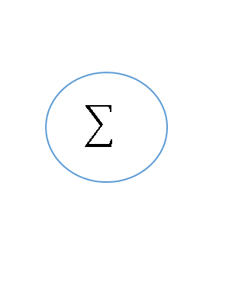
Architecture
NLP Based Question & Answering Model diagram
New
Job Description
NLP
Job Descriptions
Feature Extraction
SKILL/ROLE/DEPT
Auto Tagging
Model
Corpus
Text
Pre-processing
Model Training
Word
Tokenizer
Custom NER
Entities
Skills/Roles/Department
Predicted Tags
QA System
Metadata
Q1……….
A1……….
Q2……….
A2……….
.
.
Q_{N}……….
A_{N}……….
Question & Answer Set
Skills
Corpus
API
Pre-processing
Roles/Responsibility
TD-IDF
Vectorizer
Department
Similarity Score

Slide 9
Named Entity Recognition (NER)
Job Description:
looking for senior product manager with 10+ years of relevant work experience in machine learning
Word Tokenizer
Custom NER
Words (Unigram/Bigram) | Count
machine learning | 70
product manager | 32
python | 22
big data | 20
data scientist | 17
Words | Count | Tags
machine learning | 70 | SKILLS
product manager | 32 | ROLES
python | 22 | SKILLS
big data | 20 | SKILLS
data scientist | 17 | ROLES
{
'entities':
[
(20, 34, 'ROLES'),
(82, 97, SKILLS')
]
}

Slide 10
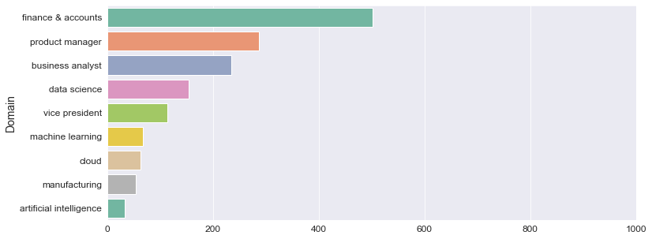
Dataset
Prepared the corpus for 9 Domains with 1506 Job descriptions as shown below with following columns domain, title, description and clean_description and tags
Prepared the required Tags Dictionary manually from the list of identified Bag of Words
Created Custom Named Entity Recognition model to identify the Skills, Roles and Responsibilities
Example {'entities': [(12, 30, 'ROLES'), (69, 84, 'ROLES'), (99, 122, 'SKILLS'), (1131, 1135, 'SKILLS'), (1625, 1634, 'SKILLS'), (1834, 1842, 'ROLES')]}

Slide 11
Text Parsing and Exploratory Data Analysis (EDA)
Exploratory Data Analysis is the process of exploring data, generating insights, testing hypotheses, checking assumptions and revealing underlying hidden patterns in the data.
Cleaning and stripping HTML
Removing Escaping characters, newline & extra spaces
Removing Stop words
Case Normalization
Expand Contractions / Transforming abbreviations
Remove punctuation
Text encoding - Removing accented characters
Tokenization
Visualization

Slide 12
Comparative Study
Algorithms
NLP
Word embeddings
TF-IDF
Glove
LSTM
BERT
Packages
Spacy
Simple Transformers
Keras Tensorflow

Slide 13
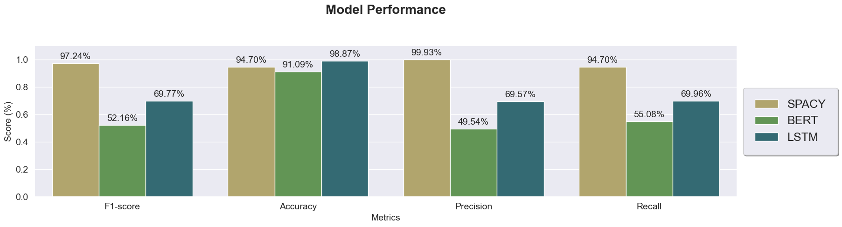
Model Performance
Below are the most commonly used evaluation metrics for NER systems
In this experiment, we compare the performance of Spacy, BERT and LSTM models. The results of this work indicates that the SPACY extraction method is the best choice.

Slide 14

Deployment
FastAPI: - FastAPI framework, high performance, easy to learn, fast to code, ready for production
Model Loader
HTML/CSS
SPACY
Flask Server
UI
API-Tags
JD Input
Send Predicted Data
FAST API
BERT
LSTM
API-QA
Question Answers
User

Slide 15
Highlights of our Solution
Auto-Tagging
The model can do the tagging of required tags automatically from the Bag of Words.
In future if we have to add new domain, the auto-tagging will help us extracting the tags and building the corpus.
Scalability
Can add more domains easily
Models
Built Spacy, BERT and LSTM Models
FastAPI
Exposed all three models as APIs using Flask Server
User Interface
Users can choose the model to retrieve the QnAs based on the model performances showed in UI.

Slide 16
Current status
Creating Dataset ✅
Pre-processing ✅
Information Extraction ✅
Analyzing different algorithms ✅
Model Building ✅
Model Evaluation ✅
Strategy to improve Model Performance ✅
Deployment strategy ✅
Deploy the model ✅

Slide 17
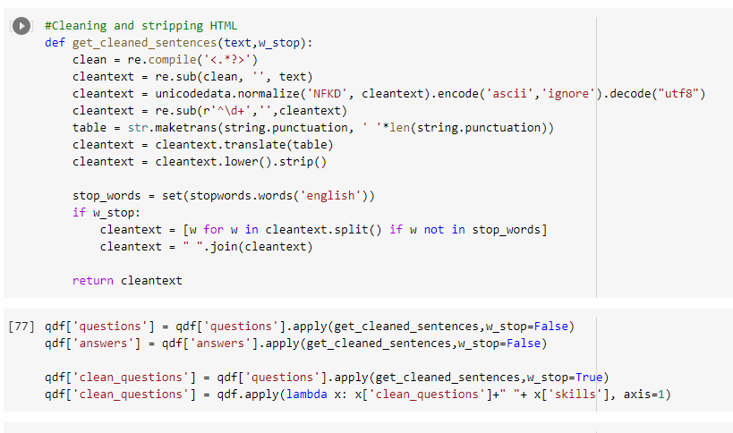
Demo

Slide 18
Future Scope
Automated web scrapping on more websites for more JDs and Q&A
Docker and containerization
ML flow
Build more channels for UI (Chatbot, Widget, Micro frontend etc.,)

Slide 19
Thank you!

